Slide 1



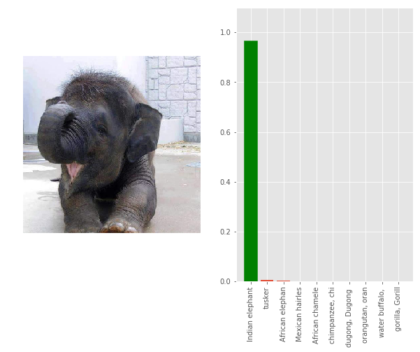
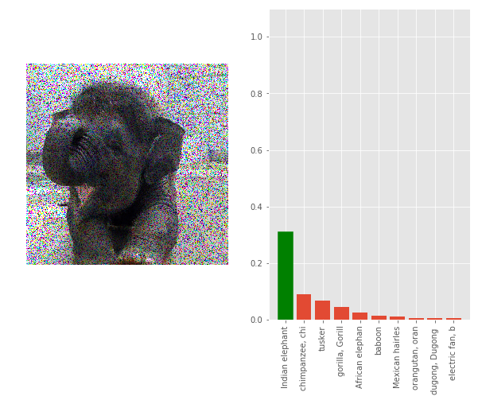
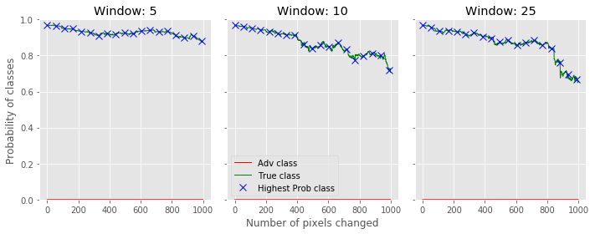
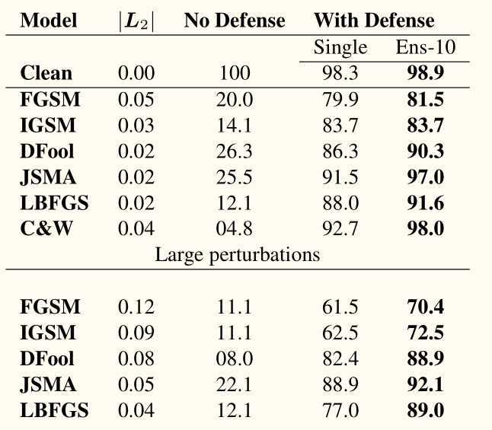
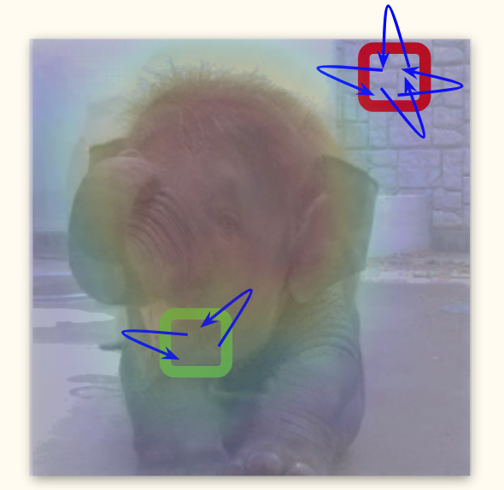
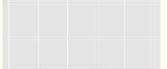
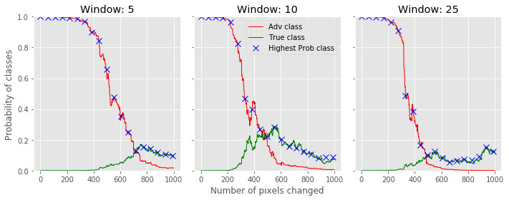
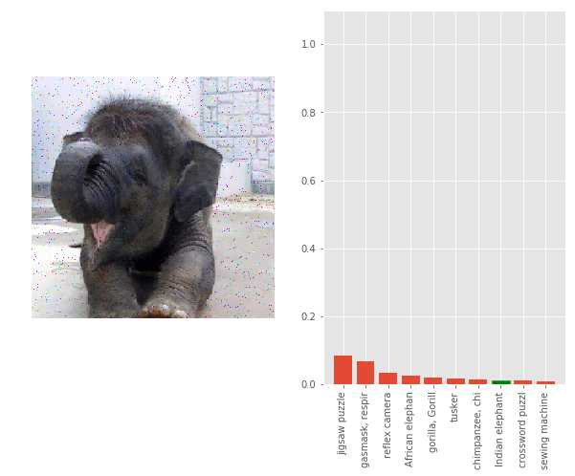
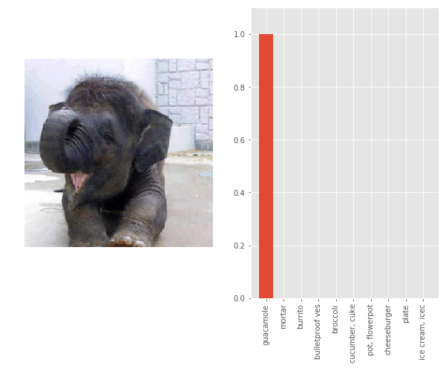
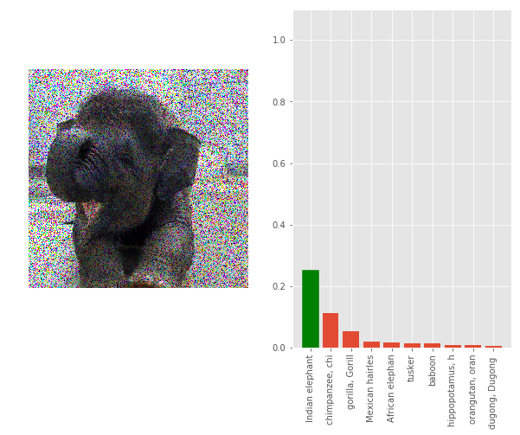
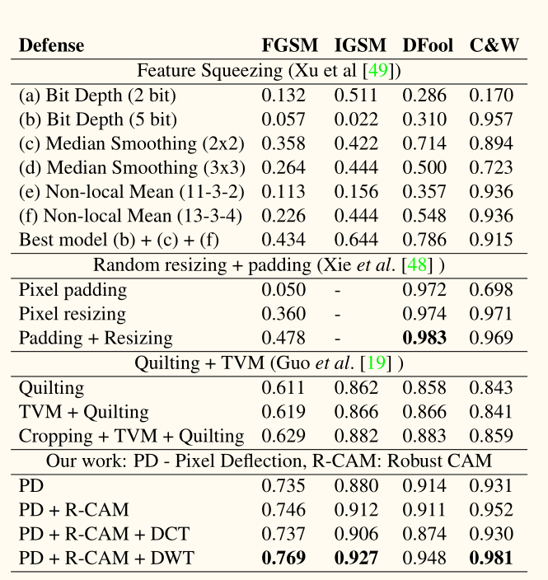
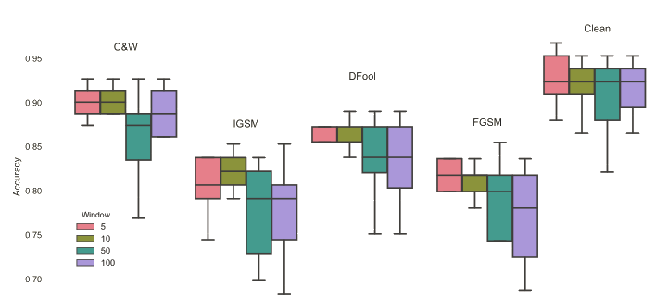
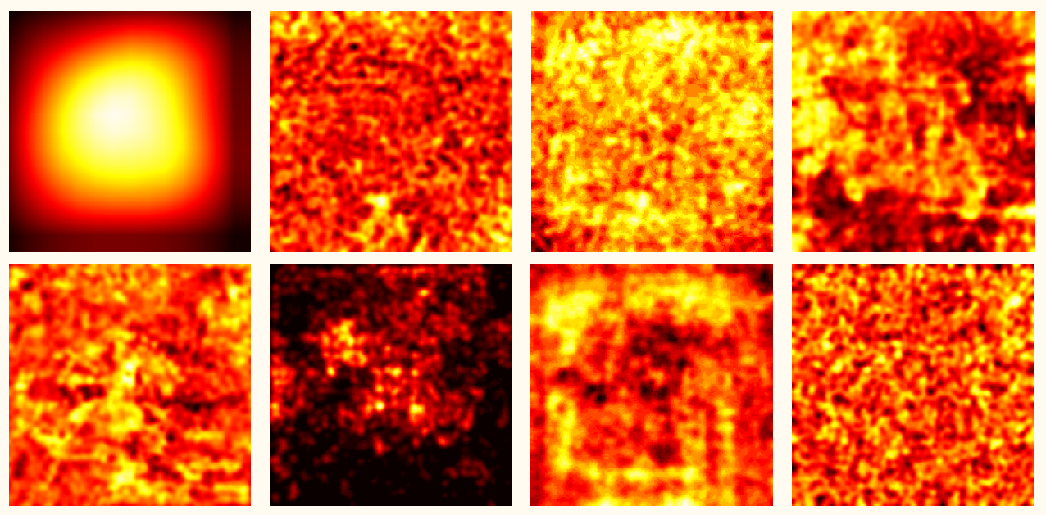
Deflecting Adversarial Attack with Pixel Deflection A. Prakash, N. Moran, S. Garber, A. DiLillo & J. Storer
aprakash@brandeis.edu, iamaaditya.github.io
Classifiers are robust to noise
but
Adversarial systems are not
www.github.com/iamaaditya/pixel-deflection
1.
Pixel Deflection
Performance
Destruction Rate
Image⇢Adversary⇢Pixel Deflection
Clean
Clean
Clean [20K]
Advr
Comparison with SOTA defenses
Advr
Advr
[1000]
Algorithm
Parameters
Classifiers look for semantic regions
but
Adversarial systems are content agnostic
Input : Image I, deflections K,
window w, activation map M
Output: Image I’
I’ ↤ I
for i ↤ 0 to K do
Let p_{i} ∼ U(I)
if M[p_{i}]< U(0:1)
Let n_{i} ∼ U(R_{w}[p_{i}] Ո I)
I’[p_{i}] = I[n_{i}]
2.
Visualization showing average location in the image of semantic content (TL), and various adversarial systems.

